Slide 1


Analysis of Potential Customers and Products Recommendation based on E-commerce Log
Zihao Wang

Slide 2
Problem Statement – This study is intended to identify potential customers who have buying willingness and what products they are going to buy.
Research Question 1– Is a user going to buy items in a given session?
Research Question 2– If a customer wants to buy, what would be the products this user will buy?

Slide 3
Outline
Research Process
RQ1 Method
RQ1 Results
RQ2 Method
RQ 2Results
Conclusion

Slide 4
Process
Select users who have willingness to buy products
Select features for buying willingness prediction
Use neural network and KNN to analysis if users want to buy products
Generate a set of users with buying willingness
Calculate accuracy for training and testing dataset
Compare the performance between 2 models
Predict users items preferences if they want to buy products
Implement Markov chain to predict users’ preferable products
Generate a set of users with predicted users’ preferable products
Calculating accuracy of selected dataset

Slide 5
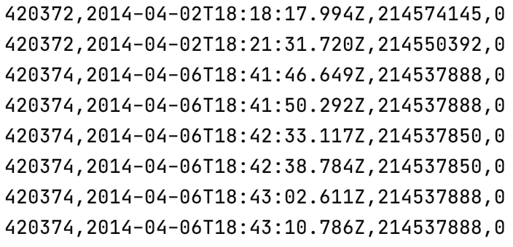
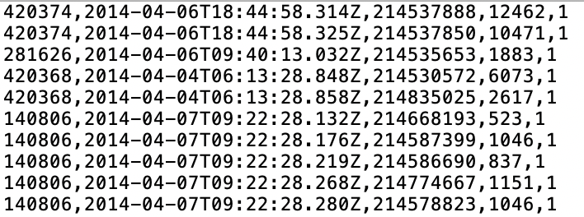
Data Collection
Use e-commerce search logs from RecSys 2015 challenge
1. clicked events:
2. bought events data:
Session ID
Timestamp
Item ID
Category
Session ID
Timestamp
Item ID
Price
Quantity

Slide 6
RQ1: Mining potential customers with buying willingness
Feature Description | Number/Type
Time features of the start/end of the session (day of week, hour) | 4 Category
Length of the session in seconds (dwell time) | 1 Number
Number of clicks | 1 Number
Number of items | 1 Number

Slide 7
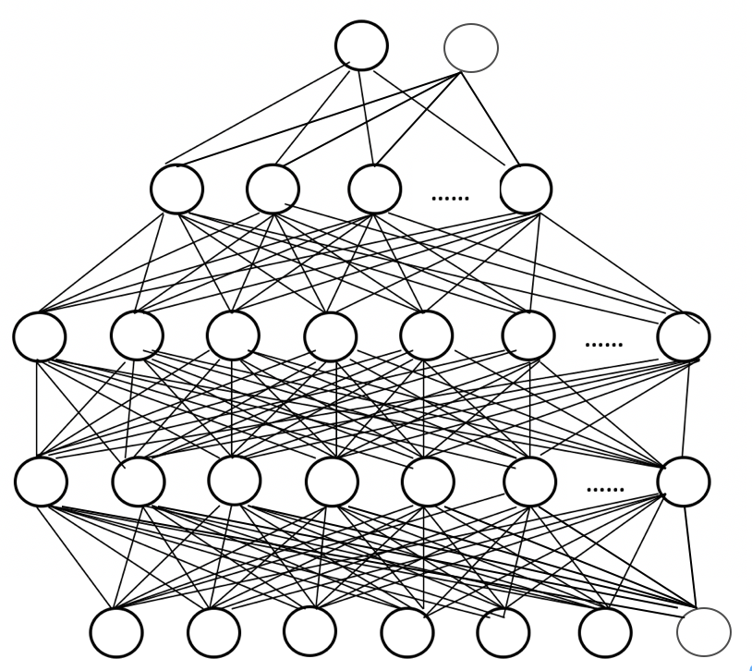
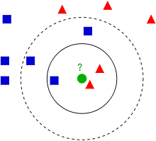
RQ1: Neural network and KNN
Output: 2 neurons,
Activation function: SoftMax
Loss function: cross-entropy
3rd hidden: 16 neurons,
Activation function: tanh
2nd hidden: 32 neurons,
Activation function: tanh
1st hidden: 32 neurons,
Activation function: tanh
Input: 7 neurons
MLP Neural network
KNN

Slide 8
RQ1: Results
Dataset description
 | Total number of users | Number of users with buy willingness | Number of users without buy willingness
Training MLP | 9,229,729 | 508,621 | 8,721,108
Training KNN | 1,000,000 | 55,042 | 944,958
Validation | 10,000 | 529 | 9471
Testing | 10,000 | 546 | 9454
Total | 9,249,729 | 509,696 | 8,740,033

Slide 9
RQ1: Results
MLP confusion matrix
 | Without purchase intend | With purchase intend
Without purchase intend | 8888 | 566
With purchase intend | 537 | 9
KNN confusion matrix
 | Without purchase intend | With purchase intend
Without purchase intend | 8948 | 506
With purchase intend | 476 | 70
 | Accuracy | True Positive Rate
MLP | 89% | 2%
KNN (K=1) | 90% | 13%

Slide 10
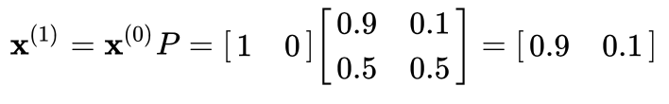
RQ2:Customers preferable products prediction
First-order Markov Chain
Given the weather on day 0
Sunny | Rain
1 | 0
Transition matrix
Predict the weather on day 1
To
 | Sunny | Rain
Sunny | 0.9 | 0.1
Rain | 0.5 | 0.5
From

Slide 11
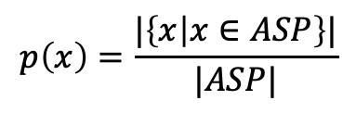
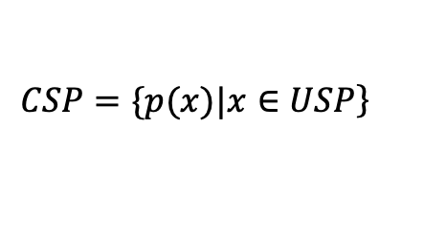

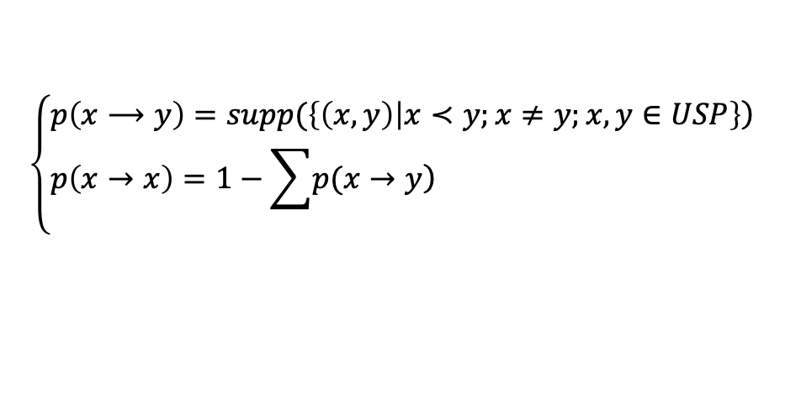
RQ2:Customers preferable products prediction
actual searched products (ASP) set
current state probability (CSP)
distribution
Session ID | Actual selected products
1 | 214536502, 214536500, 214536506, 214577561
2 | 214662742, 214662742, 214825110, 214757390, 214757407, 214551617
3 | 214716935, 214774687, 214832672
4 | 214836765, 214706482
6 | 214701242, 214826623
$$\left.CSP=\{p(x)|x∈USP\right\}$$
$$p\left(x\right)=\frac{|\left\{x | x∈ASP\right\}|}{|ASP|}$$
unique selected products (USP) set
transition matrix
Session ID | Unique selected products
1 | 214536502, 214536500, 214536506, 214577561
2 | 214662742, 214825110, 214757390, 214757407, 214551617
3 | 214716935, 214774687, 214832672
4 | 214836765, 214706482
6 | 214701242, 214826623
$$\left\{\begin{aligned}&\left.p\left(x⟶y\right)=supp(\left\{\left(x,y\right) | x≺y;x≠y;x,y∈USP\right\}\right) \\ &p\left(x→x\right)=1−\sum{\left.p(x→y\right)}\end{aligned}\right.$$
$supp\left(X\right)=\frac{|\left\{X⊆T\right\}|}{|T|}$.

Slide 12
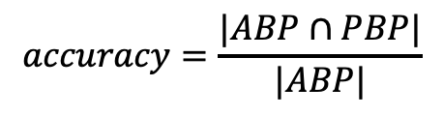
RQ2:Result
actual bought products (ABP)
Session ID | Actual selected products
11 | 214821371
87 | 214652220, 214840483, 214743369, 214826837, 214820392, 214826908, 214819430
predicted buying products (PBP)
Session ID | Unique selected products
11 | 214821371, 214821275, 214706462, 214743335, 214563337,
87 | 214826908, 214826837, 214840483, 214819430, 214743369, 214820392, 214717286, 214586694, 214718385, 214819760, 214819376
$$accuracy=\frac{|ABP∩PBP|}{|ABP|}$$

Slide 13
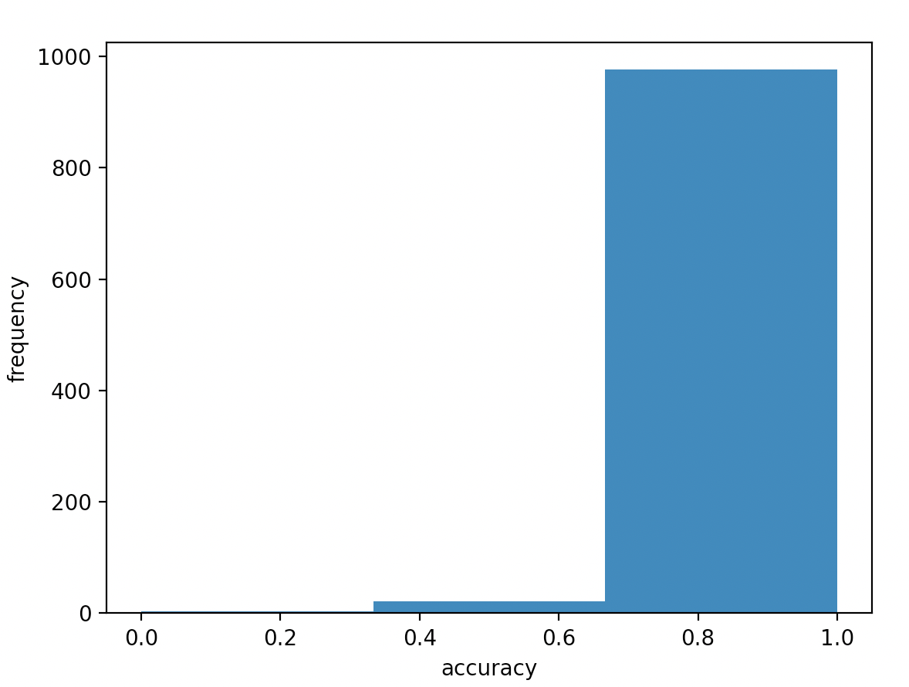
RQ2:Result
1000 customers, average accuracy=97%

Slide 14
Conclusion
RQ1: KNN has capacity to recognized users with buying willingness
The model cannot find enough customers with purchase intention.
It should take more effort to real application
RQ2: the first-order Markov chain can precisely find users’ interesting products
It can effectively apply to real applications

